Slide 1


Tunisian republic Ministry of higher Education and scientific research
University of Sfax Faculty of Sciences Sfax
Department of Computer sciences and Communications
Final Year Project
MSK Academy
E-learning web application
Realised by
Afra Kout Ahmed Adam Boussarsar
Technical supervisor
Mr. Mohamed Sami Khiari
Academic supervisor
Mr. Mohamed Mhiri
Academic Year : 2023-2024

Slide 2
MSK Academy
Plan
1
INTRODUCTION
Project’s context
2
3
Working Methodology and Specification of Requirements
Sprints development
4
5
Implementation
6
Conclusion and Perspectives

Slide 3
MSK Academy
Plan
1
INTRODUCTION
Project’s context
2
3
Working Methodology and Specification of Requirements
Sprints development
4
5
Implementation
6
Conclusion and Perspectives

Slide 4
MSK Academy
INTRODUCTION
Plan

Slide 5
MSK Academy
1
INTRODUCTION
Monumental shift in education
Beyond traditional classrooms
Rise of e-learning
Democratizing education
Convenient and accessible learning
1
Plan

Slide 6
MSK Academy
1
INTRODUCTION
Upskilling for career advancement
Pusuing personal interests
Adapting to remote learning environments
2
Plan

Slide 7
MSK Academy
Plan
1
INTRODUCTION
Project’s context
2
3
Working Methodology
Analysis and Specification of Requirements
4
5
Implementation
6
Conclusion and Perspectives

Slide 8
MSK Academy
Plan
1
INTRODUCTION
Project’s context
2
3
Working Methodology
Analysis and Specification of Requirements
4
5
Implementation
6
Conclusion and Perspectives

Slide 9
MSK Academy
Project’s context

Slide 10

Project’s context
2
Web/mobile application development
Artificial intelligence
MSK TECHNOLOGIES
A Software development company
Established in 2014
Based in Sousse
SEO marketing
Cybersecurity services for network and website protection
3

Slide 11



The issue
2
Project’s context
Lack of motivation and engagement
01
02
Difficulty in retaining and recalling information
03
02
Difficulty in sustaining attention
03
4

Slide 12

Proposed solution
2
Project’s context
03
Maintining course quality by regularly reviewing and updating the content
01
Enhancing User experience through clear layouts and responsive design
04
Interactive learning using gamification ( badges, leaderboards…) for enjoyable healthy competition
02
Real-time interaction between candidates and tutors through live sessions
05
Progress tracking features encouraging the candidates to be more engaged
5

Slide 13
MSK Academy
Plan
1
INTRODUCTION
Project’s context
2
3
Working Methodology and Specification of Requirements
Sprints development
4
5
Implementation
6
Conclusion and Perspectives

Slide 14
MSK Academy
Plan
1
INTRODUCTION
Project’s context
2
3
Working Methodology and Specification of Requirements
Sprints development
4
5
Implementation
6
Conclusion and Perspectives

Slide 15
MSK Academy
Working Methodology and Specification of Requirements
3

Slide 16

Working methodology | Scrum
3
Working Methodology and Specification of Requirements
6

Slide 17





MSK Academy
3
Working Methodology and Specification of Requirements
Functional requirements
User Registration and Authentication
Course Enrollment and Management
01
02
Content Delivery
Interaction Features
03
04
Progress Tracking
05
7

Slide 18




MSK Academy
3
Working Methodology and Specification of Requirements
Non-Functional requirements
Performance
Security
Usability
Availability
8

Slide 19
Actors
3
Working Methodology and Specification of Requirements
Administrator
Candidates
Tutors
9

Slide 20
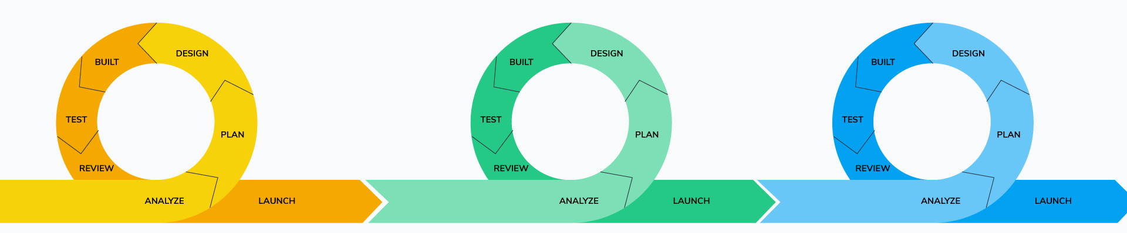
Sprint planning
3
Working Methodology and Specification of Requirements
Sprint 2
“Courses management”
Sprint 3
“Course progress tracking and engagement management”
Sprint 1
“User registration and authentication management”
10

Slide 21
MSK Academy
Plan
1
INTRODUCTION
Project’s context
2
3
Working Methodology and Specification of Requirements
Sprints development
4
5
Implementation
6
Conclusion and Perspectives

Slide 22
MSK Academy
Plan
1
INTRODUCTION
Project’s context
2
3
Working Methodology and Specification of Requirements
Sprints development
4
5
Implementation
6
Conclusion and Perspectives

Slide 23
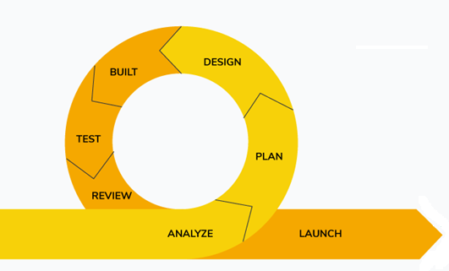
Sprint 1 « User Registration and Authetication Management »
Sprints Development
4
11

Slide 24
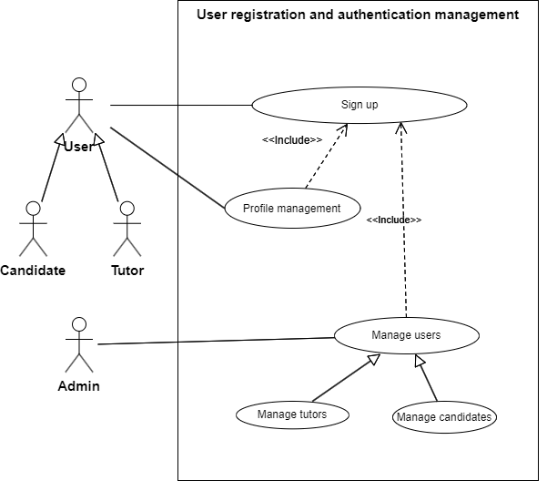
Use Case Diagram
Sprints Development
4
12

Slide 25
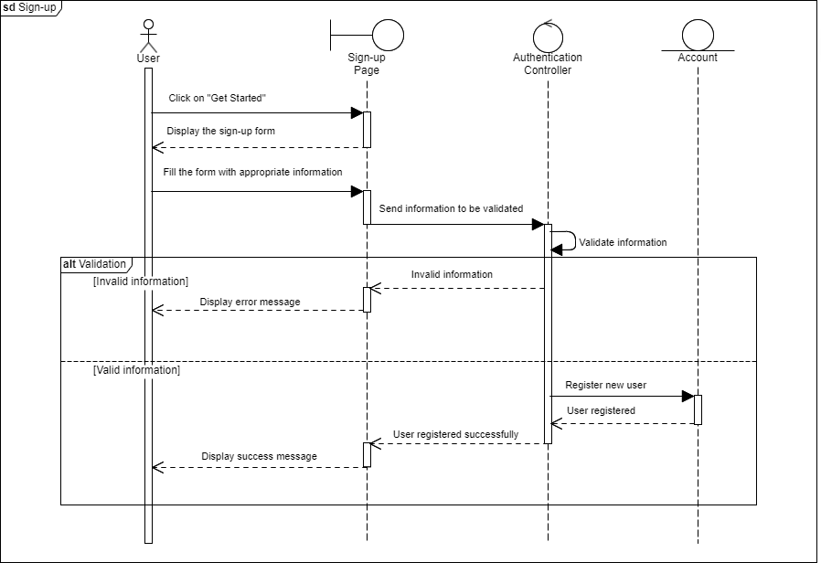
Sequence Diagram
Sprints Development
4
13

Slide 26
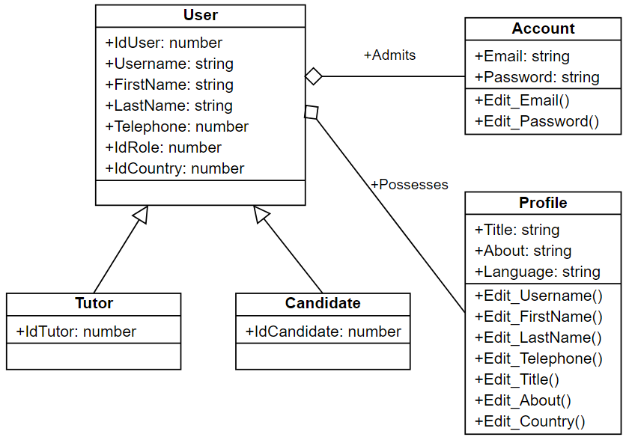
Class Diagram
Sprints Development
4
14

Slide 27
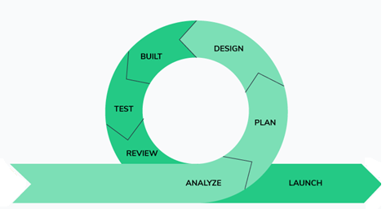
Sprint 2 « Courses Management »
Sprints Development
4
15

Slide 28
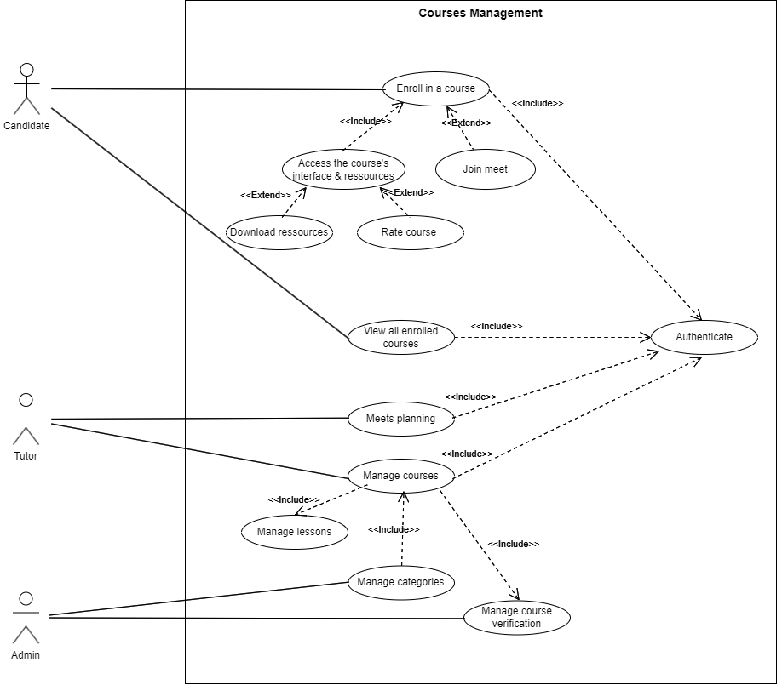
Use Case Diagram
Sprints Development
4
16

Slide 29
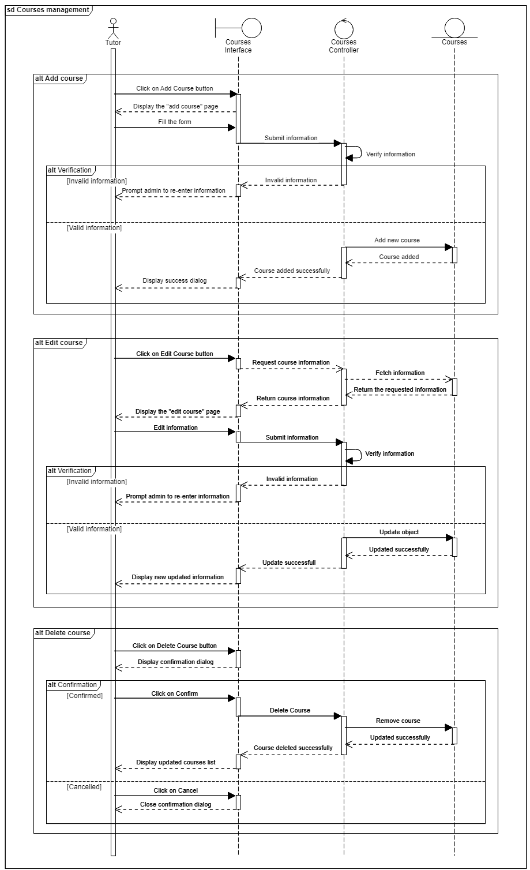
Sequence Diagram
Sprints Development
4
17

Slide 30
Sequence Diagram
Sprints Development
4
18

Slide 31
Sequence Diagram
Sprints Development
4
19

Slide 32
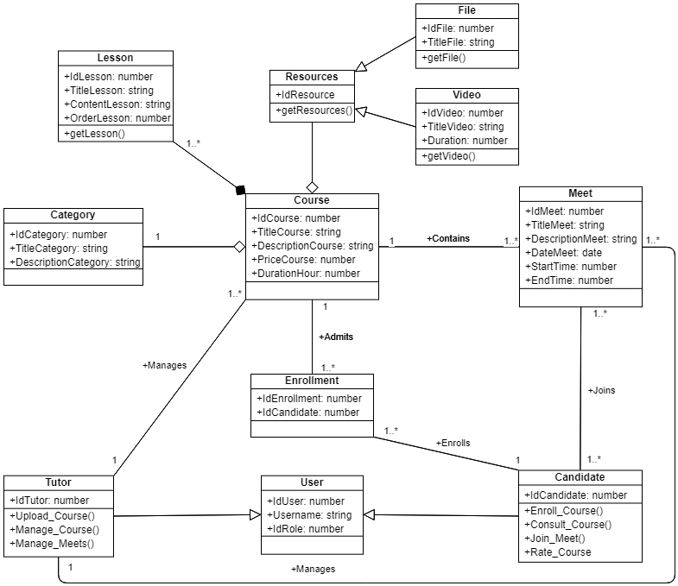
Class Diagram
Sprints Development
4
20

Slide 33
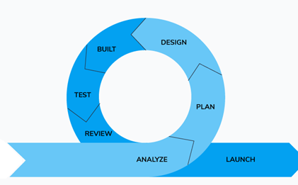
Sprint 3 « Course Progress Tracking and Engagement Management »
Sprints Development
4
21

Slide 34
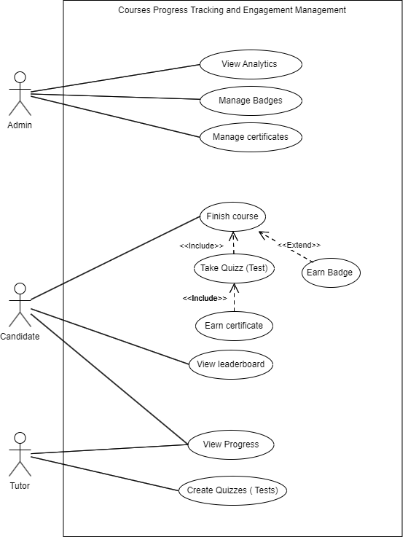
Use Case Diagram
Sprints Development
4
22

Slide 35
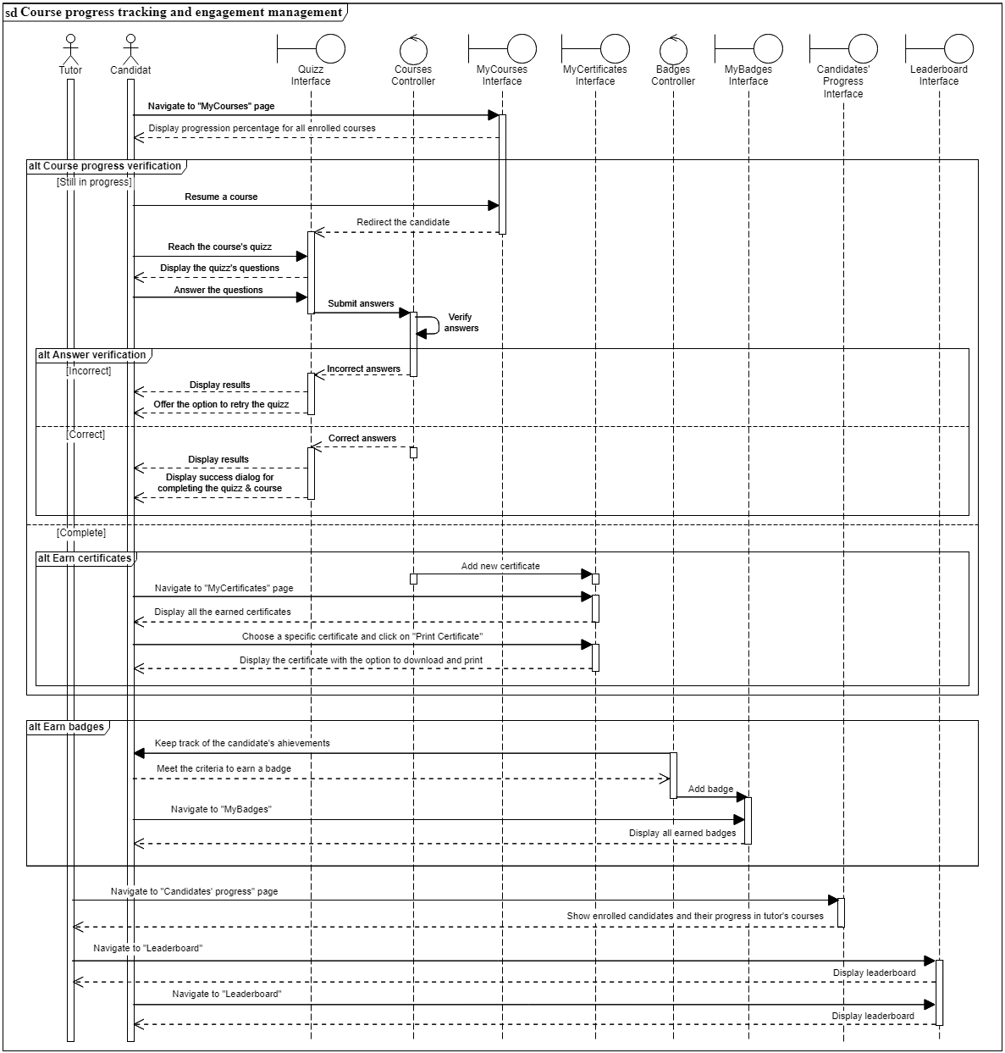
Sequence Diagram
Sprints Development
4
23

Slide 36
Sequence Diagram
Sprints Development
4
24

Slide 37
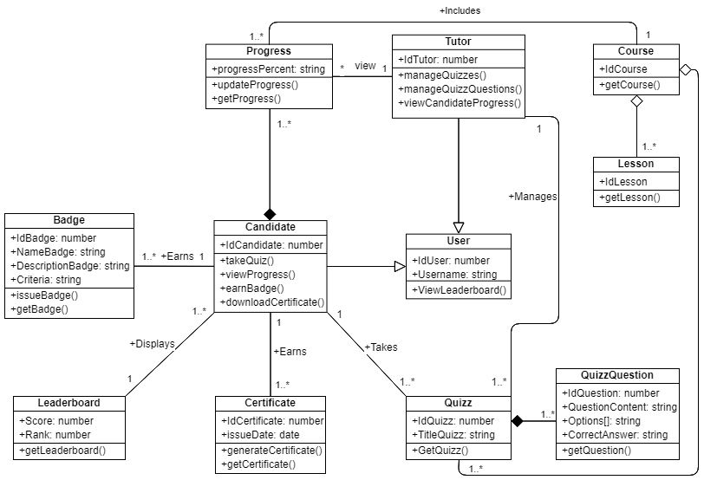
Class Diagram
Sprints Development
4
25

Slide 38
MSK Academy
Plan
1
INTRODUCTION
Project’s context
2
3
Working Methodology and Specification of Requirements
Sprints development
4
5
Implementation
6
Conclusion and Perspectives

Slide 39
MSK Academy
Plan
1
INTRODUCTION
Project’s context
2
3
Working Methodology and Specification of Requirements
Sprints development
4
5
Implementation
6
Conclusion and Perspectives

Slide 40
MSK Academy
Implementation

Slide 41




Application’s Architecture
5
Implementation
0. Open App
1. Make request
<Template/>
API ROUTING
Binding
5. Display response
Component
Controller
Model
4. Return request
2. Parse request
3. Get data from database
26

Slide 42
5
Implementation

Slide 43
MSK Academy
Plan
1
INTRODUCTION
Project’s context
2
3
Working Methodology and Specification of Requirements
Sprints development
4
5
Implementation
6
Conclusion and Perspectives

Slide 44
MSK Academy
Plan
1
INTRODUCTION
Project’s context
2
3
Working Methodology and Specification of Requirements
Sprints development
4
5
Implementation
6
Conclusion and Perspectives

Slide 45
MSK Academy
Conclusion and Perspectives

Slide 46
Conclusion
Conclusion
and Perspective
6
Engagement and motivation
Skill development and Mastery
Gamification , interactive content
Progress Tracking, focusing on skill acquisition and mastery rather than just completing
Personalised learning
Retention and application knowledge
Customized learning experience, Real-time feedback and support
Active learning, Gamified Assessments
Collaboration and social learning
Flexibility and accessibility
Anytime, Anywhere
Real time interactions
27

Slide 47




Perspectives
Conclusion
and Perspective
6
New features
Parental access features,
Partnerships with educational establishments
Mobile app
making learning on-the-go more accessible and convenient
Globalisation
Ambitious plans for expansion and development, aiming to achieve global recognition
28

Slide 48
Thank you for your attention

Slide 49
Q&A?

